Slide 1
Some Cost-Modeling Topics for Prospective Redesign of the U.S. Consumer Expenditure Surveys
Jeffrey M. Gonzalez and John L. Eltinge
Office of Survey Methods Research
NISS Microsimulation Workshop
April 7, 2011

Slide 2
Disclaimer
The views expressed here are those of the authors and do not necessarily reflect the policies of the U.S. Bureau of Labor Statistics, nor of the FCSM Subcommittee on Statistical Uses of Administrative Records.

Slide 3
Outline
Background
  Consumer Expenditure Surveys (CE) and redesign
  Conceptual information
Redesign options
  Responsive partitioned designs
  Use of administrative records
Prospective evaluation using microsimulation methods
Additional considerations

Slide 4
Background

Slide 5
Mission statement
The mission of the CE is to collect, produce, and disseminate information that presents a statistical picture of consumer spending for the Consumer Price Index (CPI), government agencies, and private data users.

Slide 6
The Gemini Project
Rationale for survey redesign
  Challenges in social, consumer, and data collection environments
Mission of Gemini
  Redesign CE to improve data quality through verifiable reduction in measurement error, focusing on under-reporting
  Cost issues also important

Slide 7
Timeline for redesign
2009—11: Hold research events, produce reports
2012: Assess user impact of design alternatives, recommend survey redesign, propose transition roadmap
2013+: Piloting, evaluation, transition

Slide 8
Primary methodological question
For a specified resource base, can we improve the balance of quality/cost/risk in the CE through the use of, for example
  Responsive partitioned designs
  Administrative records

Slide 9
Evaluation
With changes in the quality/cost/risk profile, must distinguish between
  Incremental changes (e.g., modified selection probabilities, reduction in number of callbacks)
  Fundamental changes (partitioned design, new technologies, reliance on external data sources)

Slide 10
Redesign options

Slide 11
Potential redesign options
New design possibilities
  Semi-structured interviewing
  Partitioned designs
  Global questions
  Use of administrative records
New data collection technologies
  Financial software
  PDAs, smart phones

Slide 12
Partitioned designs
Extension of multiple matrix sampling, also known as a split questionnaire (SQ)
  Raghunathan and Grizzle (1995); Thomas et al. (2005)
Involve dividing questionnaire into subsets of survey items, possibly overlapping, and administering subsets to subsamples of full sample
Common examples: TPOPS, Census long-form, Educational testing

Slide 13
Methods for forming subsets
Random allocation
Item stratification (frequency of purchase, expenditure category)
Correlation based
Tailored to individual sample unit

Slide 14
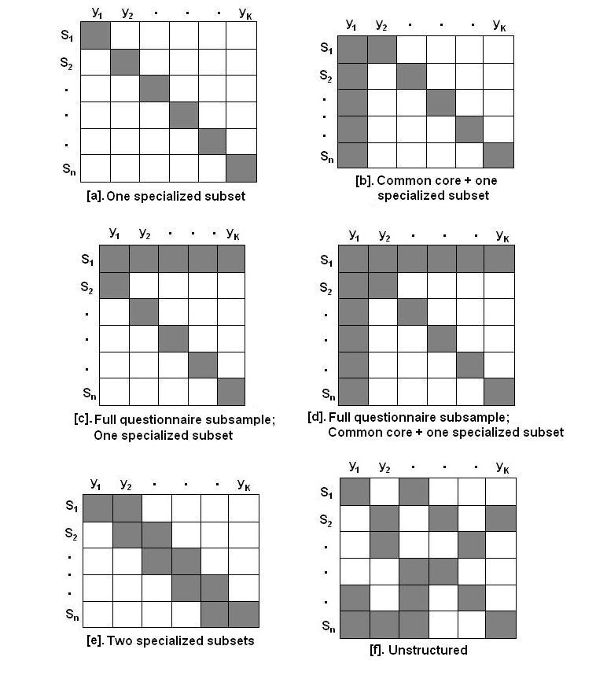
Graphic illustrating SQ designs

Slide 15
Potential deficiency of current methods
Heterogeneous target population
Surveys inquiring about “rare” events and other complex behaviors
Incomplete use of prior information about sample unit

Slide 16
Responsive survey design
Actively making mid-course decisions and survey design changes based on accumulating process and survey data
  Double sampling, two-phase designs
Decisions are intended to improve the error and cost properties of the resulting statistics

Slide 17
Components of a responsive design
Identify survey design features potentially affecting the cost and error structures of survey statistics
Identify indicators of cost and error structures of those features
Monitor indicators during initial phase of data collection

Slide 18
Components of a responsive design (2)
Based on decision rule, actively change survey design features in subsequent phases
Combine data from distinct phases to produce single estimator

Slide 19
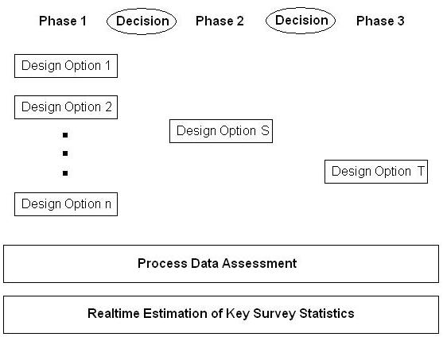
Illustration of a three-phase responsive design (from Groves and Heeringa [2006])

Slide 20
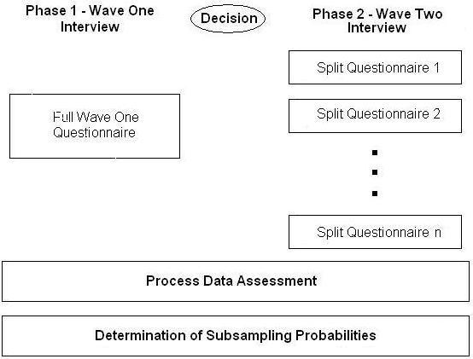
Responsive SQ design

Slide 21
Examples of administrative records
Sales data from retailers, other sources
  Aggregated across customers, by item
  Possible basis for imputation of missing items or disaggregation of global reports
Collection of some data (with permission) through administrative records (e.g., grocery loyalty cards) linked with sample units

Slide 22
Evaluation of administrative record sources
Prospective estimands
  Population aggregates (means, totals)
  Variable relationships (regression, GLM)
  Cross-sectional and temporal stability of (a), (b)
Integration of sample and administrative record data
  Multiple sources of variability

Slide 23
Cost structures
Costs likely to include
  Obtaining data (provider costs, agency personnel)
  Edit, review, and management of microdata
  Modification and maintenance of production systems
Each component in (1) will likely include high fixed cost factors, as well as variable factors
Account for variability in costs and resource base over multiple years

Slide 24
Methodological and operational risks
Distinguish between
  Incremental risks, per standard statistical methodology
  Systemic risks, per literature on “complex and tightly coupled systems”
    Perrow (1984, 1999); Alexander et al. (2009); Harrald et al. (1998); Johnson (2002); Johnson (2005); Leveson et al. (2009); Little (2005)

Slide 25
Prospective Evaluation using microsimulation methods

Slide 26
Microsimulation modeling
Primary goal
  Describe events and outcomes at the person-level
Main components (Rutter, et al., 2010)
  Natural history model
  Intervention model

Slide 27
Application to redesign
Understanding, identification of distinct states of underlying behavior (e.g., purchase) and associated characteristics (e.g., amount)
Effect of “intervention” (i.e., redesign option) on capturing (1)

Slide 28
Natural history model
Consumer Behavior
Household demographics
Motivation
Lifestyle
New product introduction
Brand preference
Substitution

Slide 29
Developing the natural history model
Identify fixed number of distinct states and associated characteristics
Specify transition probabilities between states
Set values for model parameters

Slide 30
Intervention model
Consumer behavior
Survey
Statistical products
Redesign option

Slide 31
Intervention model (2)
Attempting to model unknown fixed/random effects
Input on cost/error components from field staff and paradata
Insights from lab studies, field tests, other survey experiences

Slide 32
Examples of intervention model inputs
Partitioned designs
  Likelihood of commitment from field staff
  Cognitive demand on respondents (e.g., recall/context effects)
Administrative records
  Availability
  Linkage
  Respondent consent

Slide 33
Additional considerations

Slide 34
Discussion
Data needs for model inputs, parameters
  Subject matter experts
  Users
Model validation and sensitivity analyses
  Parameter omission
  Errors in information

Slide 35
Discussion (2)
Effects of ignoring statistical products, stakeholders
  Full family spending profile
  CPI cost weights
Dimensions of data quality
  Total Survey Error
  Total Quality Management (e.g., relevance, timeliness)

Slide 36
References
Alexander, R., Hall-May, M., Despotou, G., and Kelly, T. (2009). Toward Using Simulation to Evaluation Safety Policy for Systems of Systems. Lecture Notes in Computer Science (LNCS) 4324. Berlin: Springer.
Gonzalez, J. M. and Eltinge, J. L. (2007). Multiple Matrix Sampling: A Review. Proceedings of the Section on Survey Research Methods, American Statistical Association, 3069—75.
Groves, R. M. and Heeringa, S. G. (2006). Responsive Design for Household Surveys: Tools for Actively Controlling Survey Errors and Costs. Journal of the Royal Statistical Society, Series A, 169(3), 439—57.
Harrald, J. R., Mazzuchi, T. A., Spahn, J., Van Dorp, R. , Merrick, J., Shrestha, S., and Grabiwski, M. (1998). Using System Simulation to Model the Impact of Human Error in a Maritime System. Safety Science 30, 235—47.
Johnson, C. (ed.) (2002). Workshop on the Investigation and Reporting of Incidents and Accidents (IRIA 2002). GIST Technical Report G2002-2, Department of Computing Science, University of Glasgow, Scotland.

Slide 37
References (2)
Johnson, David E. A. (2005). Dynamic Hazard Assessment: Using Agent-Based Modeling of Complex, Dynamic Hazards for Hazard Assessment. Unpublished Ph.D. dissertation, University of Pittsburg Graduate School of Public and International Affairs.
Leveson, N., Dulac, N., Marais, K., and Carroll, J. (2009). Moving Beyond Normal Accidents and High Reliability Organizations: A Systems Approach to Safety in Complex Systems. Organizational Safety, 30, 227—49.
Little, R.G. (2005). Organizational Culture and the Performance of Critical Infrastructure: Modeling and Simulation in Socio-Technological Systems. Proceedings of the 38th Hawaii International Conference on Systems Sciences.
Rutter, C. M., Zaslavsky, A. M., Feuer, E. J. (2010). Dynamic Microsimulation Models for Health Outcomes: A Review. Medical Decision Making, Sage Publication, 10—8.
Raghunathan, T. E. and Grizzle, J. E. (1995). A Split Questionnaire Survey Design. Journal of the American Statistical Association, 90, 54—63.
  Thomas, N., Raghunathan, T. E., Schenker, N., Katzoff, M. J., and Johnson, C. L. (2006). An Evaluation of Matrix Sampling Methods Using Data from the National Health and Nutrition Examination Survey. Survey Methodology, 32, 217—31.

Slide 38
Jeffrey M. Gonzalez gonzalez.jeffrey@bls.gov
John L. Eltinge eltinge.john@bls.gov
Office of Survey Methods Research www.bls.gov/ore

